Slide 1
EES203: Geochemistry
Instructor: Anoop Ambili
Email id: anoop@iisermohali.ac.in

Slide 2
Elemental partioning during magmatic differentiation

Slide 3
Partition coefficient or Distribution coefficient - 1
It is assumed that at equilibrium, the ratio of concentration of a trace element in a solid phase (C_{s)} to its concentration in liquid (C_{L}) is a constant (D):
D= C_{s}/C_{L}
The constant is called PARTITION COEFFICIENT or DISTRIBUTION COEFFICIENT or NERNST PARTITION COEFFICIENT.
It is also denoted as K_{D}
Source: Faure, Chapter-8

Slide 4
Partition coefficient or Distribution coefficient - 2
If K_{D} = 1, then trace element is equally distributed between mineral and melt
If K_{D} = > 1, then trace element has a ‘preference’ for mineral phase & in the mineral-melt system under investigation and is a compatible trace element.
If K_{D} = < 1, then trace element has a ‘preference’ for melt phase & in the mineral-melt system under investigation and is a incompatible trace element.

Slide 5
BULK PARTITION COEFFICIENT
A rock is an aggregate of minerals, so the Bulk distribution coefficient for a rock for a specific element can be calculated from partition coefficients of constituent minerals weighed according to their proportion. It is defined by expression
D_{i} = x₁ K_{d1} + X₂K_{d2} + X₃K _{d3}…
D_{i} = bulk partition coefficient for element I
X₁ = modal proportion of mineral 1 etc
K_{d1} = parition coefficient for element i in mineral1
For eg. In a rock containing 50% olivine, 30% Opx & 20% cpx, the bulk partition coefficient would be
D_{i} = 0.5 K^{ol}_{d1} + 0.3K^{opx}_{d2} + 0.2K^{cpx} _{d3}…

Slide 6
Table 9-1. Partition Coefficients (CS /C L) for Some Commonly Used Trace Elements in Basaltic and Andesitic Rocks
 |  |  |  | Olivine Opx | Cpx | Garnet | Plag | Amph Magnetite
 | Rb |  |  | 0.010 0.022 0.014 0.040 0.010 0.013 14 5 0.70 10 0.007 0.03 0.006 0.02 0.006 0.03 0.007 0.05 0.007 0.05 0.013 0.15 | 0.031 0.060 0.026 7 34 0.056 0.092 0.230 0.445 0.474 0.582 | 0.042 0.012 0.023 0.955 1.345 0.001 0.007 0.026 0.102 0.243 1.940 | 0.071 1.830 0.23 0.01 0.01 0.148 0.082 0.055 0.039 1.5 0.023 | 0.29 0.46 0.42 6.8 29 2.00 7.4 0.544 2 0.843 2 1.340 2 1.804 1 1.557 1 2.024 1
 | Sr
 | Ba
 | Ni
 | Cr
 | La |  | Earth Elements
 | Ce
 | Nd
 | Sm
 | Eu
 | Dy
 | Er |  |  | 0.026 0.23 0.583 4.700 0.020 1.740 1.5
 | Yb |  | R | 0.049 0.34 | 0.542 | 6.167 | 0.023 | 1.642 1.4
 | Lu |  |  | 0.045 0.42 | 0.506 | 6.950 | 0.019 | 1.563
 | Data from Rollinson (1993). |  |  |  |  |  | * Eu³⁺/Eu²⁺ | Italics are estimated
are
Example: hypothetical garnet lherzolite = 60% olivine, 25% orthopyroxene, 10% clinopyroxene, and 5% garnet (all by weight), using the data in Table 9.1, is:
D_{Er} = (0.6 · 0.026) + (0.25 · 0.23) + (0.10 · 0.583) + (0.05 · 4.7) = 0.366

Slide 7
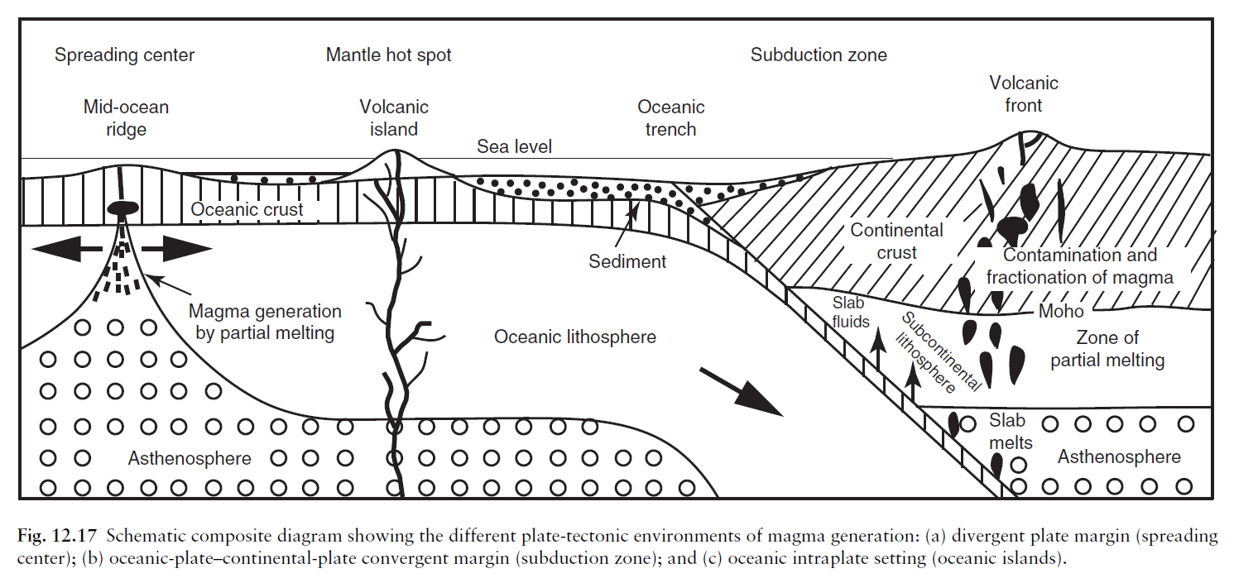
Geochemical characteristics of primary magma

Slide 8
Important questions?
What are the major compositional characteristics of primary magma?
In which tectonic settings does primary magma form?
How does the degree of partial melting influence magma composition?
How do elements fractionate during partial melting?

Slide 9
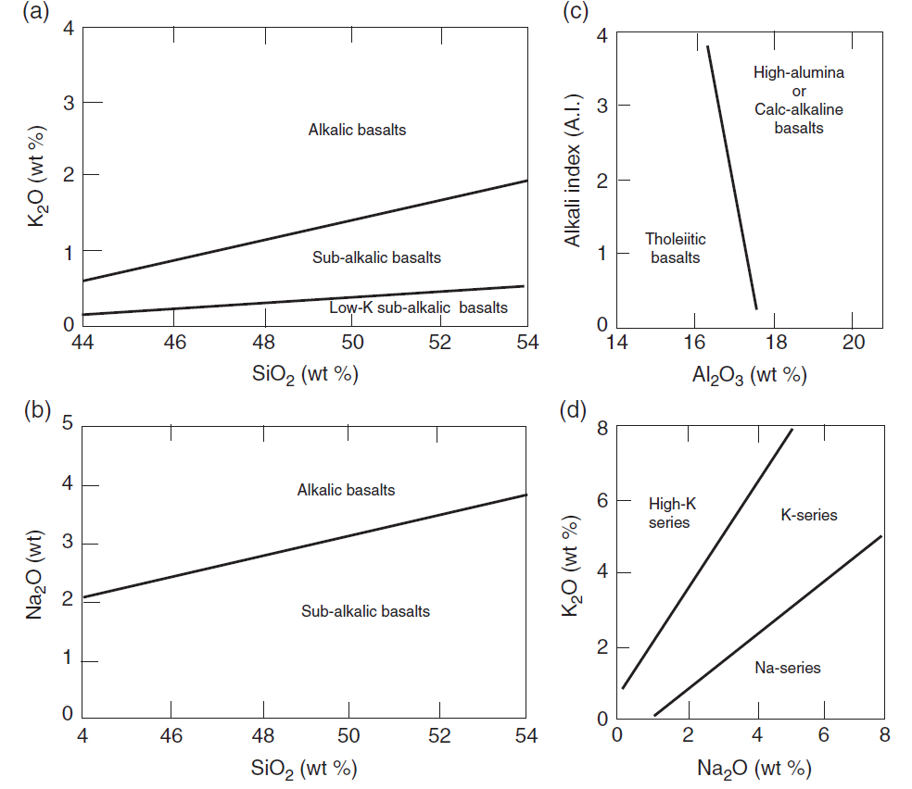
Classification of primary basaltic magma

Slide 10
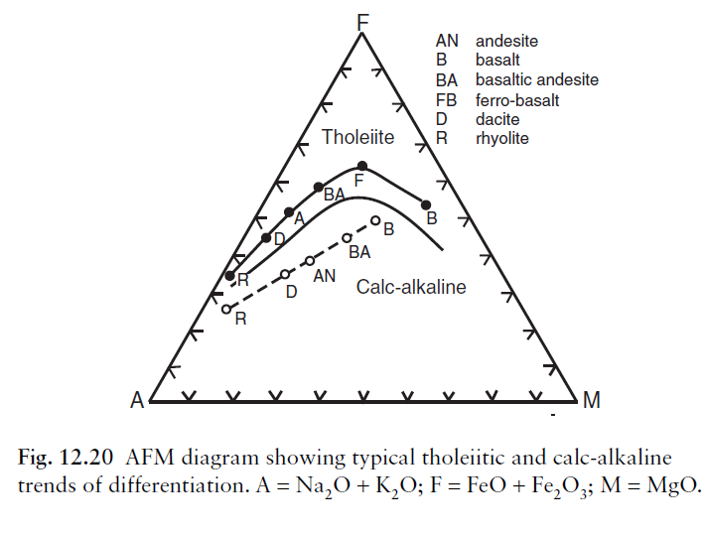
Classification of primary basaltic magma

Slide 11
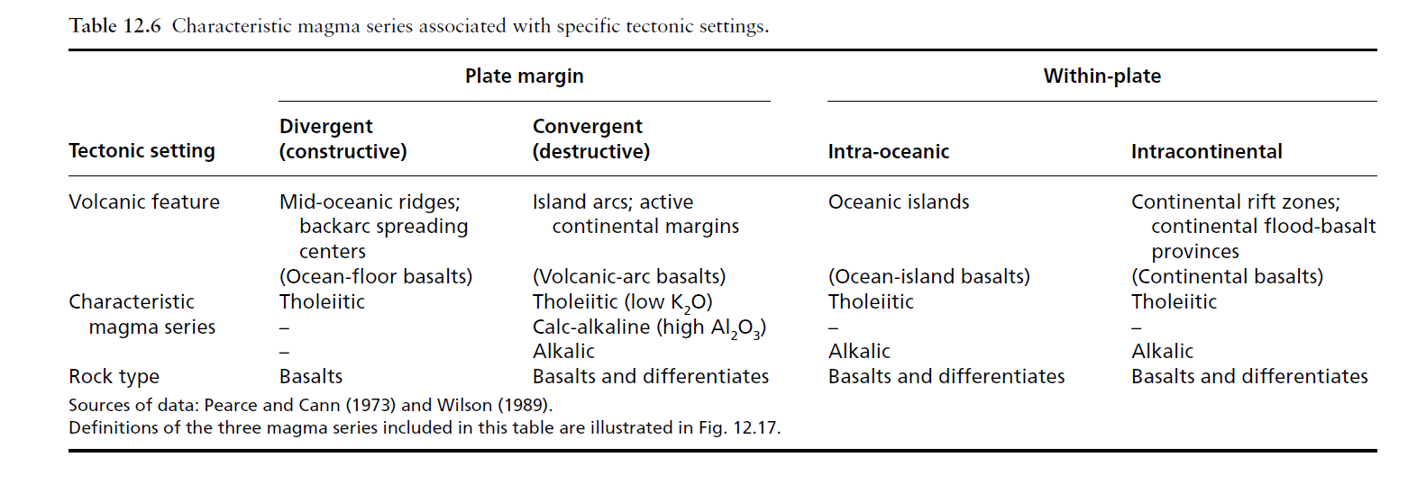
Tectonic settings of primary magma series

Slide 12
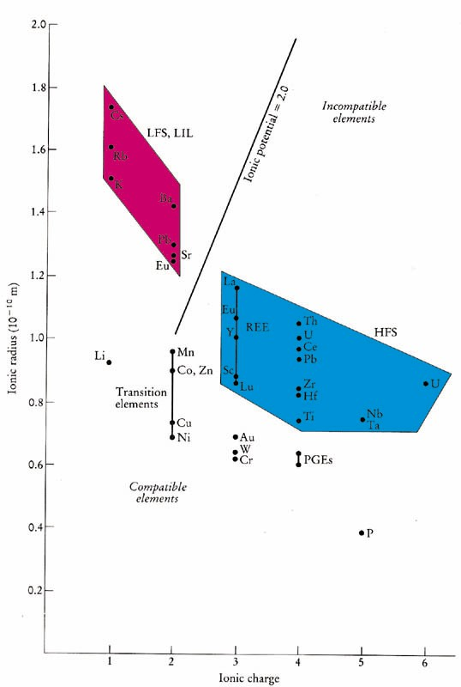
Elements having small ionic radius and a relatively low charge (such as Ni, Cr, Cu, W, Ru, Rh, Pd, Os, Ir, Pt, and Au) early phase of crystallalization
Incompatible elements commonly → two subgroups
✦ Smaller, highly charged high field strength (HFS) elements (REE, Th, U, Ce, Pb⁴⁺, Zr, Hf, Ti, Nb, Ta)
✦ Low field strength large ion lithophile (LIL) elements (K, Rb, Cs, Ba, Pb²⁺, Sr,
Eu²⁺)

Slide 13
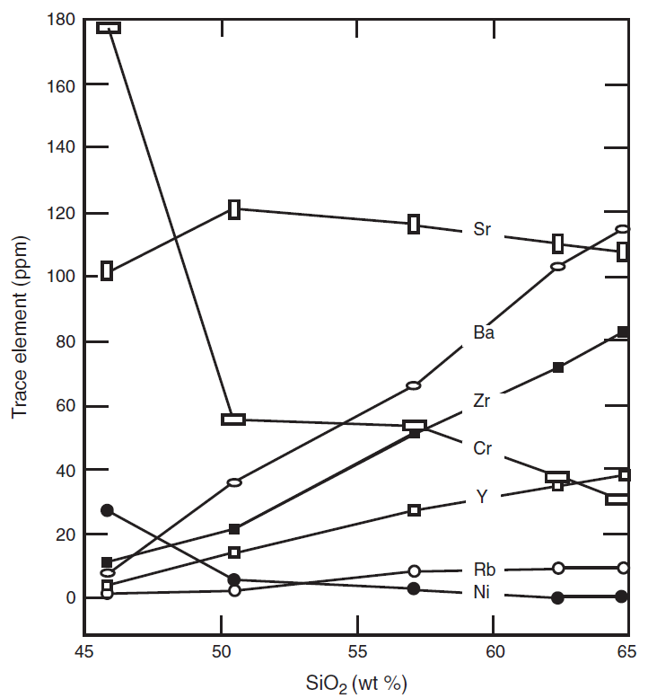
Fractionation of trace elements

Slide 14
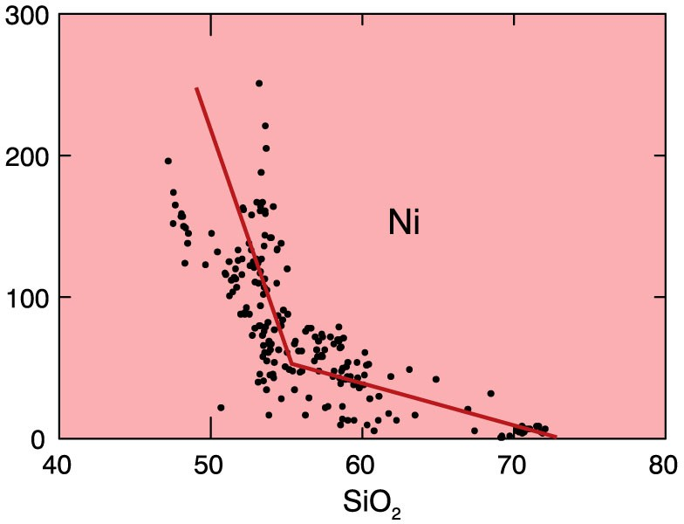
Trace elements strongly partitioned into a single mineral
Figure 9.1a. Ni Harker Diagram for Crater Lake. From data compiled by Rick Conrey. From Winter (2001) An Introduction to Igneous and Metamorphic Petrology. Prentice Hall.

